Slide 1

Java Project : boulderdash
Paul Boogaerts
Maxence kruger
Valentin Naessens
Alexis Hoyez

Slide 2
Summary
Group presentation
Context & need
Diagram
Functionality
Ways of improvement
Conclusion
Questions

Slide 3
Group presentation
Maxence
Project leader
Gif
Project report
Paul
Programmer
Hero’s movement
Alexis
Programmer
Display of the map
Valentin
Diagram
map
Group presentation
Context & need
Diagram
Functionality
Ways of improvement
Conclusion
Questions

Slide 4
Context & need
Maven
MVC
Database
Game’s constraints
Group presentation
Context & need
Diagram
Functionality
Ways of improvement
Conclusion
Questions

Slide 5
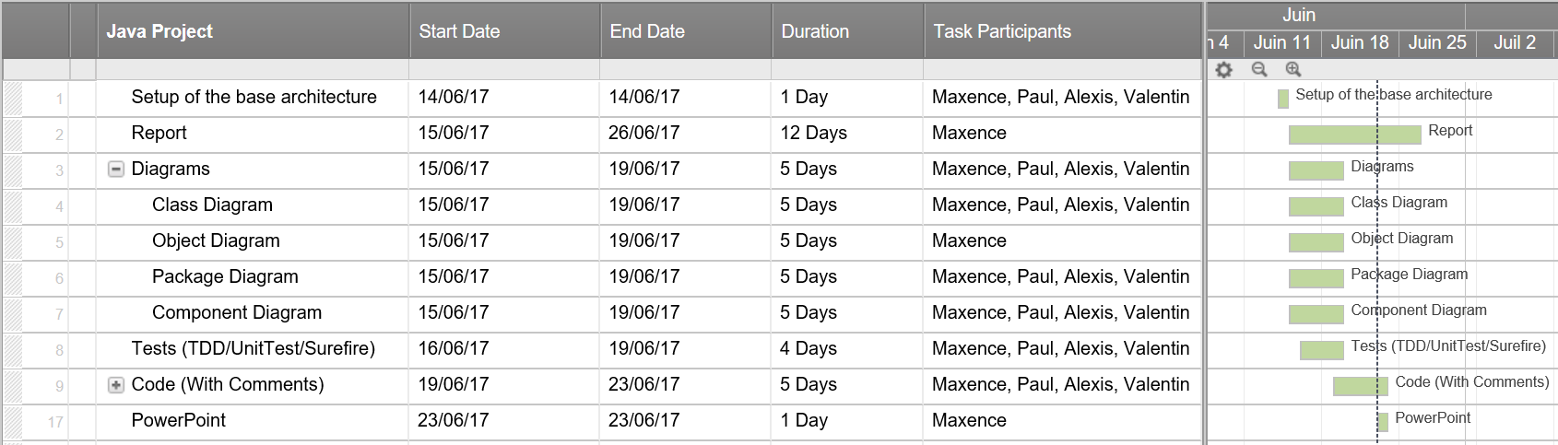
Planning
Group presentation
Context & need
Diagram
Functionality
Ways of improvement
Conclusion
Questions

Slide 6
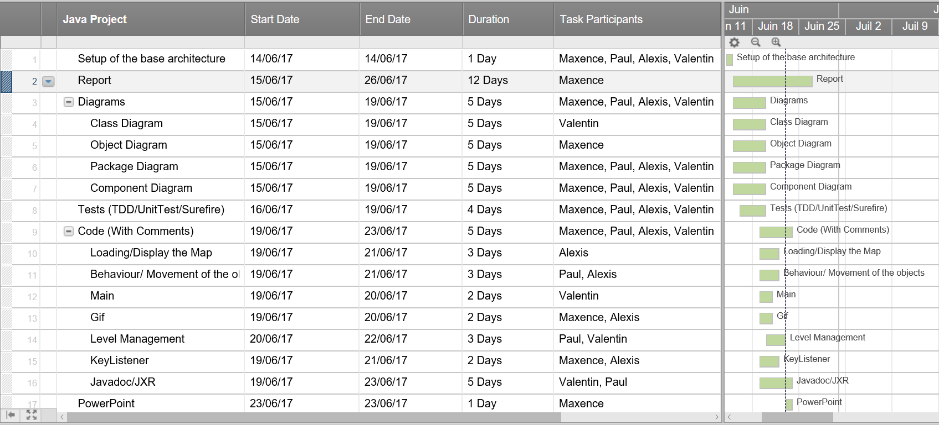
Final Planning
Group presentation
Context & need
Diagram
Functionality
Ways of improvement
Conclusion
Questions

Slide 7
need
Maven
MVC
Database
Game’s constraints
Group presentation
Context & need
Diagram
Functionality
Ways of improvement
Conclusion
Questions

Slide 8
Diagrams
Group presentation
Context & need
Diagram
Functionality
Ways of improvement
Conclusion
Questions

Slide 9
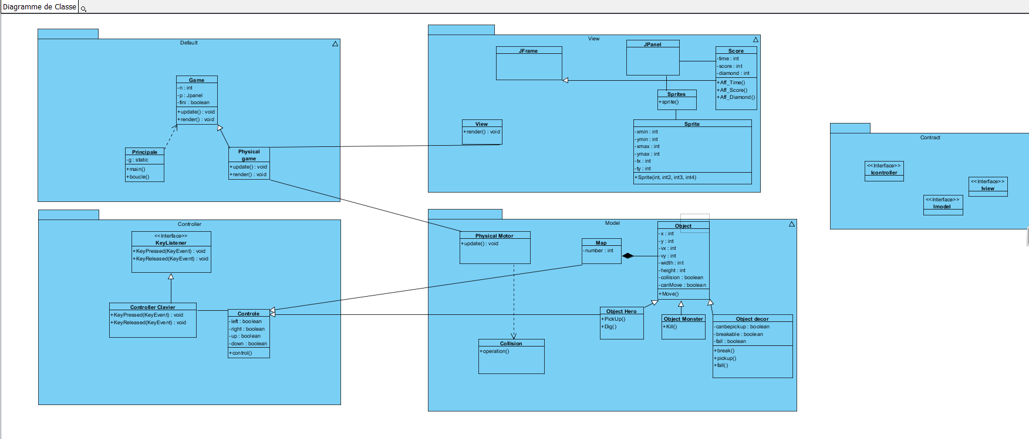
PREDICTIVE class diagram
Group presentation
Context & need
Diagram
Functionality
Ways of improvement
Conclusion
Questions

Slide 10
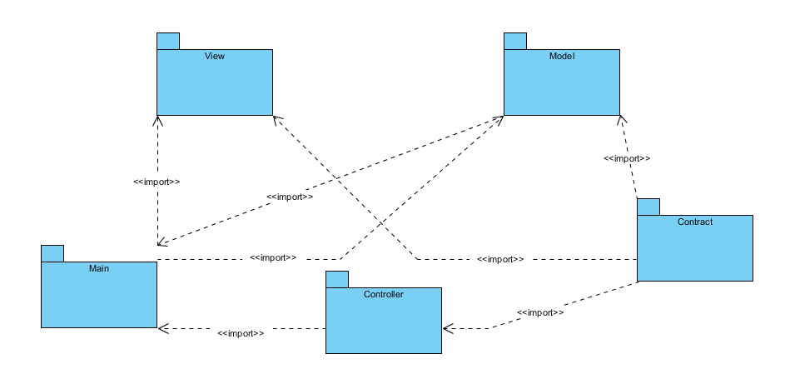
Package diagram
Group presentation
Context & need
Diagram
Functionality
Ways of improvement
Conclusion
Questions

Slide 11
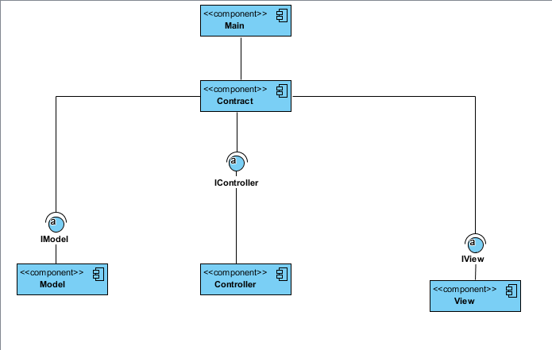
Component diagram
Group presentation
Context & need
Diagram
Functionality
Ways of improvement
Conclusion
Questions

Slide 12
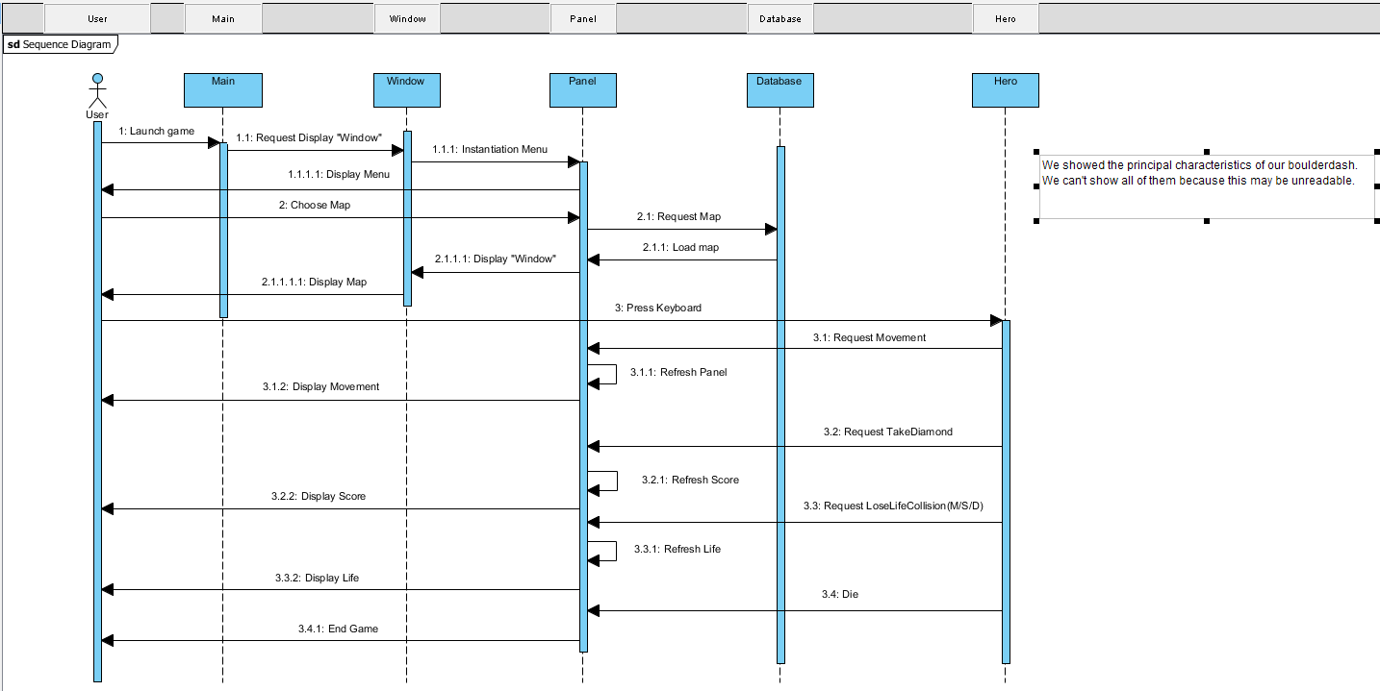
Sequence diagram
Group presentation
Context & need
Diagram
Functionality
Ways of improvement
Conclusion
Questions

Slide 13
Functionality
Group presentation
Context & need
Diagram
Functionality
Ways of improvement
Conclusion
Questions

Slide 14
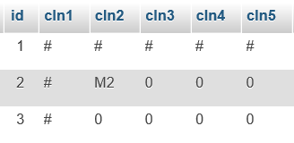
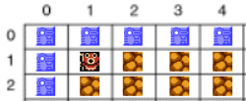
MAP
Database
Eclipse
Group presentation
Context & need
Diagram
Functionality
Ways of improvement
Conclusion
Questions

Slide 15
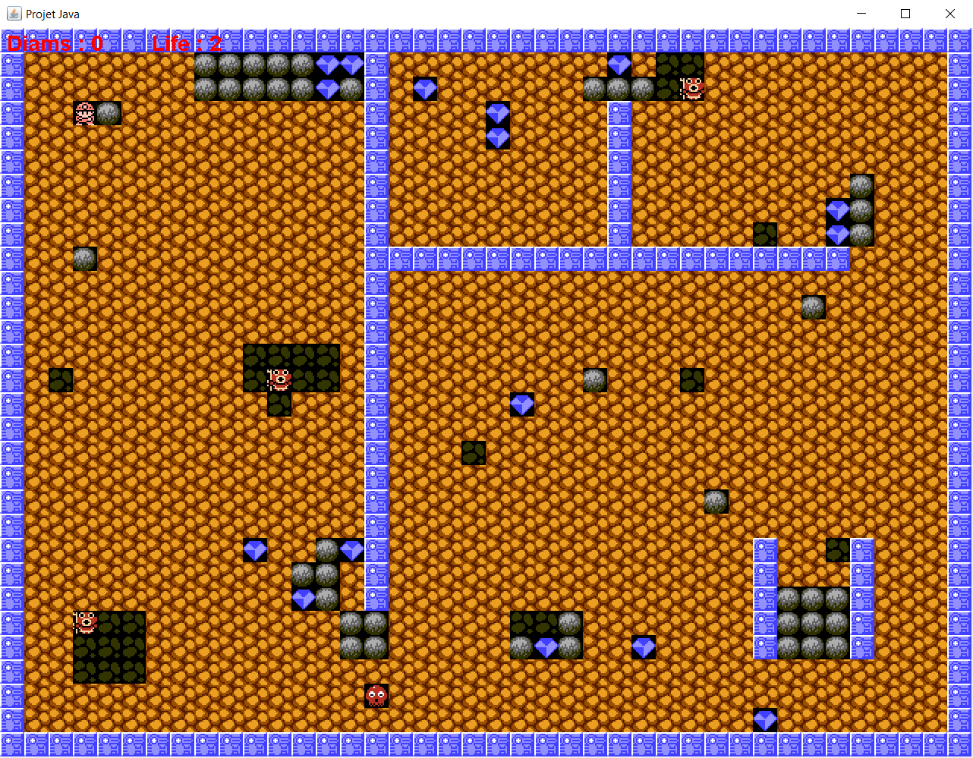
MAP
Group presentation
Context & need
Diagram
Functionality
Ways of improvement
Conclusion
Questions

Slide 16
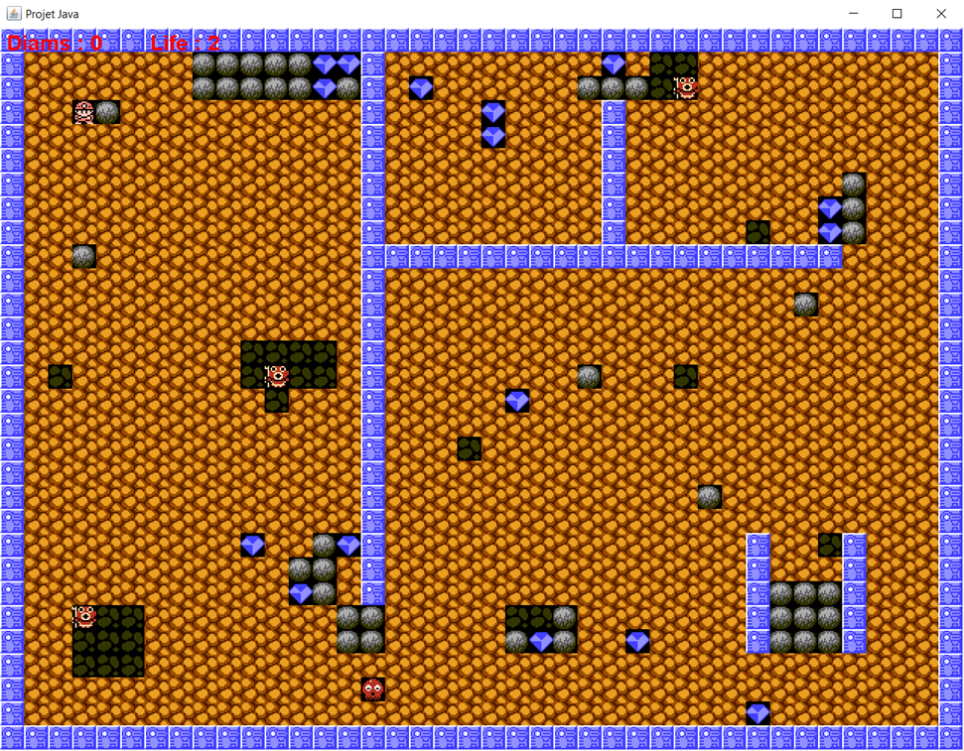
movement
Hero
Monster
Diamond
Stone
Group presentation
Context & need
Diagram
Functionality
Ways of improvement
Conclusion
Questions

Slide 17
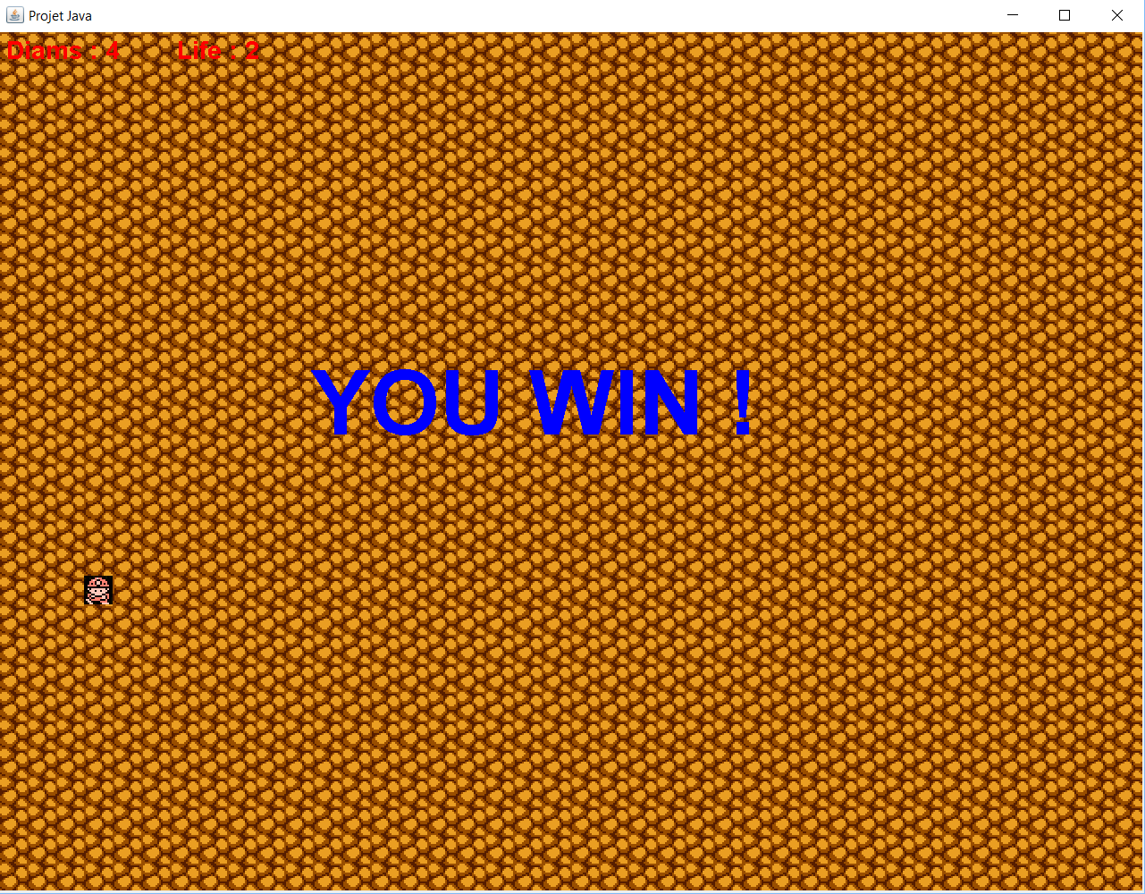
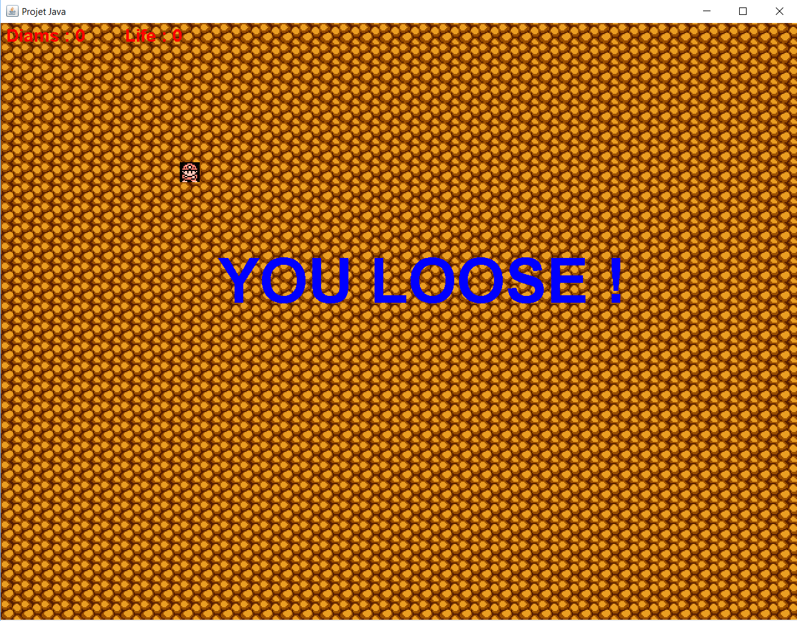
GAME WON/LOST
Game won :
Game Lost :
Group presentation
Context & need
Diagram
Functionality
Ways of improvement
Conclusion
Questions

Slide 18
Ways of improvement
MVC
Unit test
Maven
GitHub
Group presentation
Context & need
Diagram
Functionality
Ways of improvement
Conclusion
Questions

Slide 19
Conclusion
Feature reminder :
Group cohesion :
Group presentation
Context & need
Diagram
Functionality
Ways of improvement
Conclusion
Questions

Slide 20
questions
Group presentation
Context & need
Diagram
Functionality
Ways of improvement
Conclusion
Questions

